Slide 1
Sentence Boundary Disambiguation on Indonesian Text Messages
Hanif Yuli Abdillah P

Slide 2
Introduction
Sentence Boundary Disambiguation is one of the most important areas in natural language processing especially in a chatbot with an artificial intelligence technology. Problem arises when someone sends a very long text. The chatbot systems need to cut the sentence based on the context if there are more than 1 context, so the text can be processed optimally.
Sentence Boundary Disambiguation act as the first step of a natural language processing systems.
The inability to remove ambiguity from sentence constraints will affect to the entire processing system.

Slide 3
Problem Statement
Punctuation plays an important role in identifying the boundaries of a sentence in the text. In Bahasa, period ‘.’ can be the greatest source of ambiguity. Here are some function of a period:
Sentence Boundary (Main Function)
Abbreviation (Jln., Dr. S.Pd., etc)
Numerical Expression (Rp14.000, 4.5, etc)
File Naming (skripsi.docx, udinus.pptx, etc)
Website URL (www.google.com, www.facebook.com, etc)
Mail Code (893.3/484/2016, etc)
Beside punctuation, there are no fixed rules in the structure of text messages make this problem become more complicated.

Slide 4
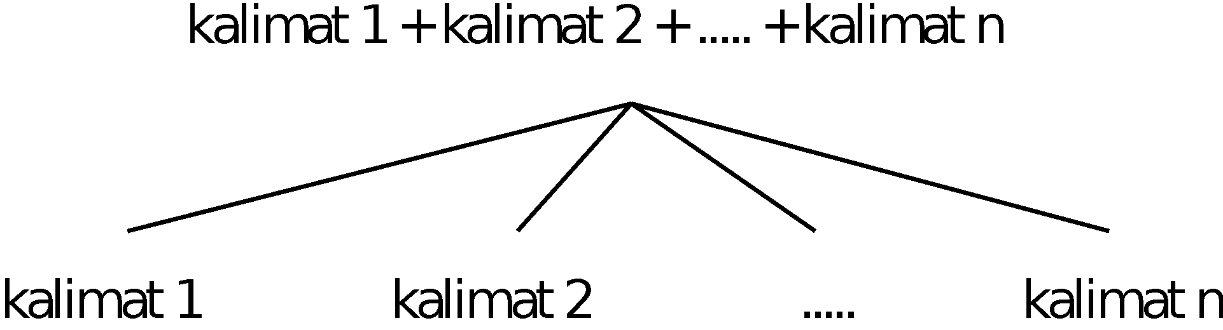
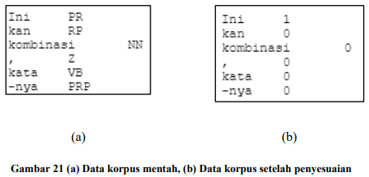

Data Collection & Modification
The data that used in this project is a modification of the main dataset in the study of (Kurniawan and Aji, 2019). Modifications were made to the sentence structure and the tagsets.
Modification of tags is done by changing the tags in the main dataset to 1 (sentence boundary) and 0 (non sentence boundary).
The sentence structure modification is done by combining several sentences into long sentences. In addition, several tokens were converted into lowercase letters and removing punctuation so that various data variations were obtained.

Slide 5
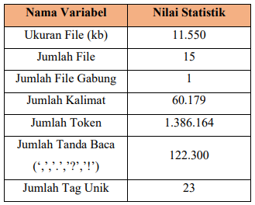
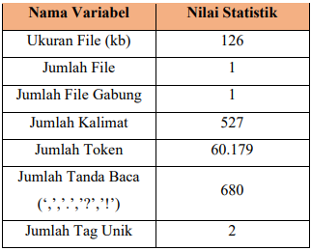
Dataset Adjusments
Main Dataset
Modificated Dataset (Used)
There are hardware spesification issues, so adjusments is done to the size of dataset.

Slide 6
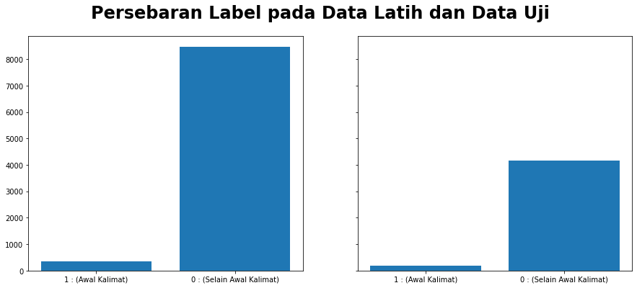
Tags Distribution
Data Latih
Data Uji
In the real environment, the sum of token or word that act as a begining (sentence boundary) is fewer than not, so i keep it as what it is.

Slide 7
Word Feature
Fitur | Keterangan
bias | Weight
next.token.title | Next token is a title
next.token.upper | Next token is an uppercase
next.token.lower | Next token is a lowercase
prev.token.istitle() | Previous token is a title
prev.token.upper | Previous token is an uppercase
prev.token.lower | Previous token is a lowercase
init.token.lower | Initial token is a lowercase
Fitur | Keterangan
init.token.title | Initial token is a title
init.token.upper | Initial token is an uppercase
init.token.digit | Initial token is a digit
init.token.copInside | Initial token has capital inside
init.token[-2:] | 2 last character of initial token
init.token[-3:] | 3 last character of initial token
init.token[2:] | 2 first character of initial token
init.token[3:] | 3 first character of initial token

Slide 8
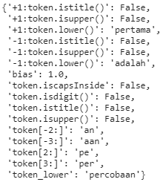
Feature Extraction
Fungsi get_feature()

Slide 9
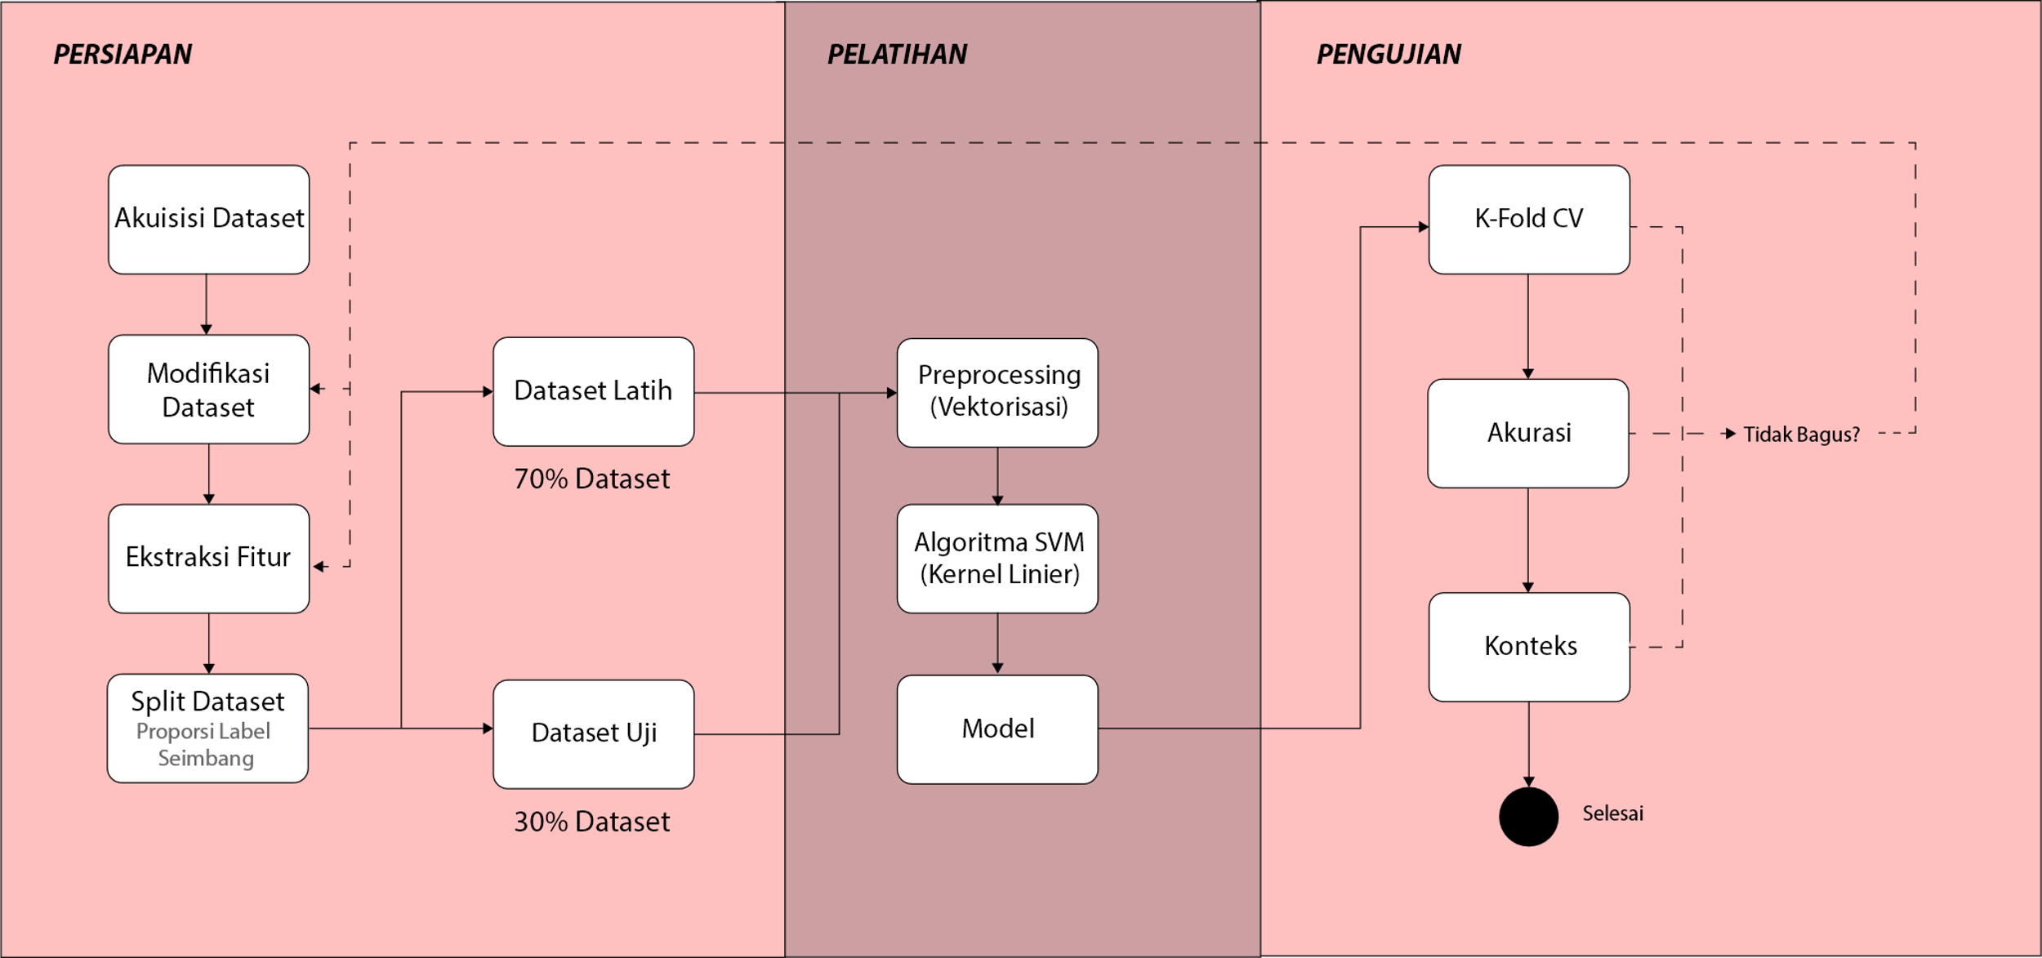
Model Development

Slide 10
Result

Slide 11
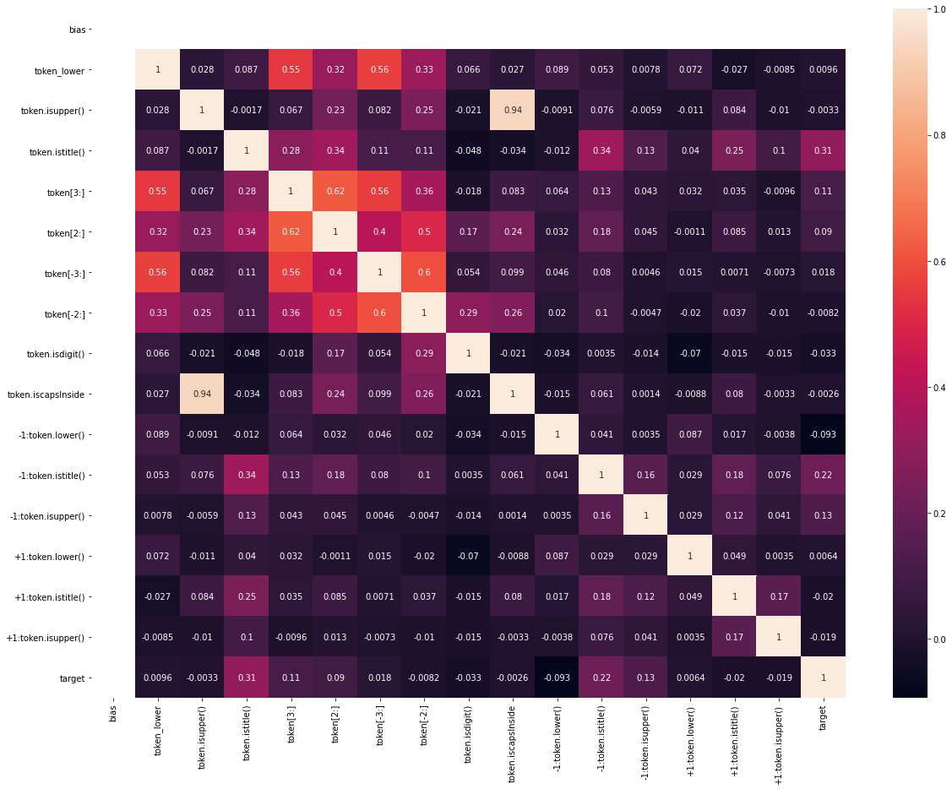
Feature Correlation
Based on the correlation analysis on each feature to the tags, there are several features that have the greatest influence in determining the label of each token.
init.token.title
prev. token.title
prev.token.upper
init.token[3:]

Slide 12
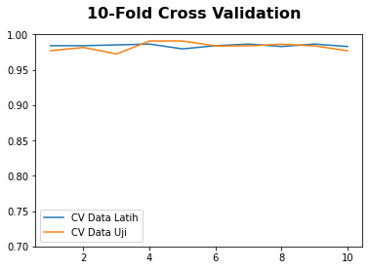
K-Fold Cross Validation
The trained model evaluated repeatedly by dividing each of the 10 subsets for training data and test data. The validation scores of the two types of data in 10 subsets obtained a fairly stable score at a score of 0.97 - 0.99
So it can be concluded that the model has a good performance based on the evaluation using the K-fold cross validation metric.

Slide 13
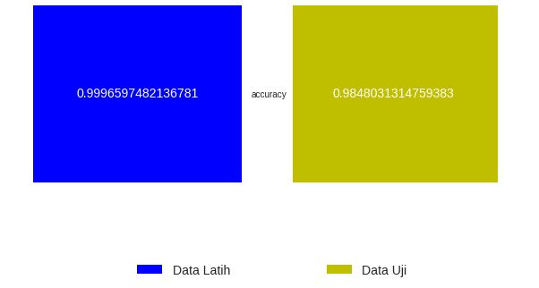
Confusion Matrix
Training Data
Label | 0 (Actual) | 1 (Actual)
0 (Predict) | 8464 | 1
1 (Predict) | 2 | 350
Evaluation Data
Tag | 0 (Actual) | 1 (Actual)
0 (Predict) | 4156 | 14
1 (Predict) | 52 | 121
Based on the results of the confusion matrix, the accuracy is quite good where the model can identify known data with an accuracy of 99.96597482136781% and unknown data with an accuracy of 98.48031314759383%.
Model doesnt has a quiet big difference in accuracy, so that the model is declared feasible to solve this problem.

Slide 14
Context Evaluation
 | Jumlah Kalimat/Konteks Aktual | S1 | S2 | S3 | S4
T1 | 2 | 2/T | 2/T | 3/F | 2/F
T2 | 3 | 3/T | 2/F | 3/F | 2/F
T3 | 2 | 2/T | 1/F | 2/T | 1/F
T4 | 1 | 1/T | 1/T | 1/T | 1/T
T5 | 4 | 7/F | 6/F | 5/T | 1/F
The test was carried out using a sample sentence made by the researcher. The resulting model has a fairly good performance in processing the first sentence structure (S1) and the worst in the fourth sentence structure (S4).
S1 🡪 Capital, punctuated
S2 🡪 Capital, unpunctuated
S3 🡪 Lowercased, punctuated
S4 🡪 Lowercased, unpunctuated

Slide 15
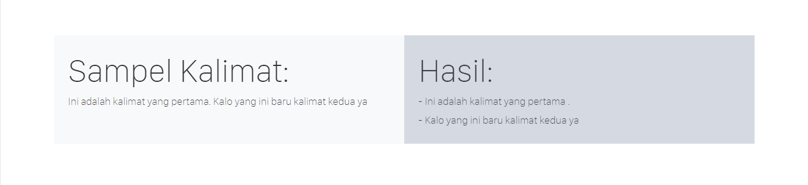

Slide 16
This project based on my final year thesis in Dian Nuswantoro Universit

